Slide 1
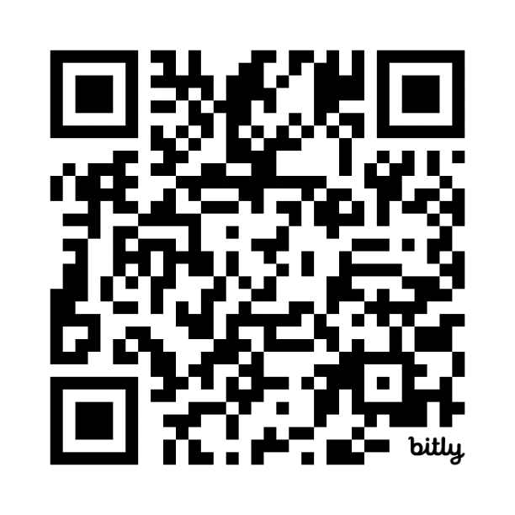
Why Choose Geriatrics?
Join APTA Geriatrics to get all-inclusive access to a community of:
7,000+ passionate PT, PTA, & Student professionals,
Education, practice resources, and job opportunities
Journal of Geriatric Physical Therapy and Journal Clubs
Online Forums community
Notes:
Speaker: Joining the APTA Geriatrics community means becoming a part of a network of over 7,000 passionate professionals, including physical therapists, physical therapist assistants, and students who share a common interest in geriatric physical therapy.
Your membership with APTA Geriatrics also ensures a sense of belonging to a like-minded community of professionals who share your passion and dedication to optimizing the aging experience. We provide you with the tools and connections to excel in your career and make a meaningful impact on the lives of aging adults.
Scan the QR Code if you have interest in joining!

